Slide 1
SDN as a SAAS in Cloud Computing

Slide 2
Covered So Far …
What is Cloud Computing?
Types of Services.
SAAS.
SDN.
Concept of SDN.

Slide 3
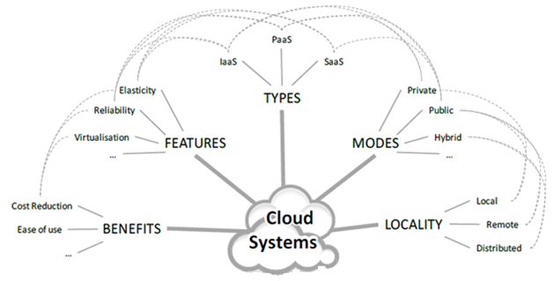

Slide 4
“Converged infrastructure” and ”Shared services”.
Sharing of resources to achieve coherence and economies of scale.
Internet-based computing i.e. involves delivering hosted services over the Internet.
“Pay as you go” model.
Services are fully managed by the providers.
Significant workload shift.

Slide 5
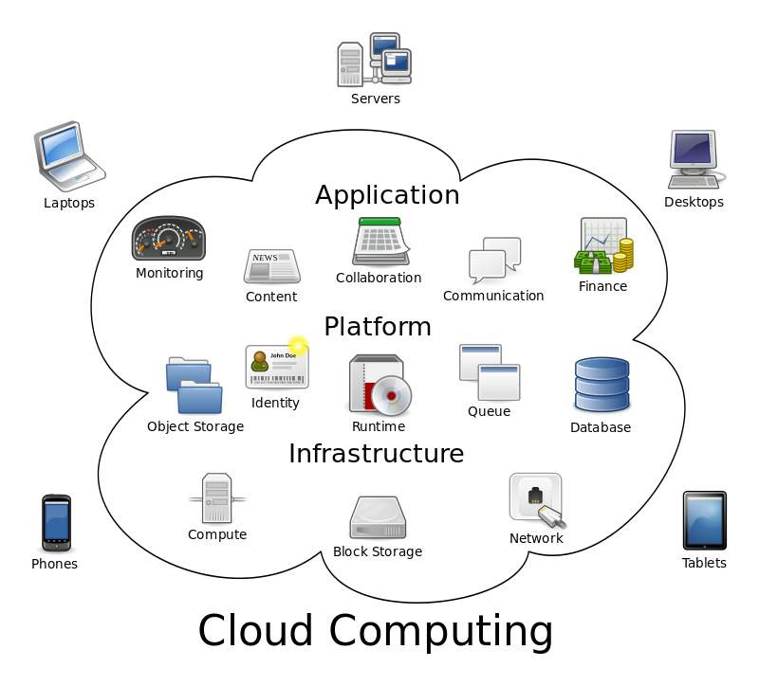
Services :

Slide 6
SAAS
Software as a service (or SaaS) is a way of delivering applications over the Internet-as a service.
The provider manages access to the application, including security, availability, and performance.
Benefits :
easier administration.
automatic updates and patch management.
compatibility: All users will have the same version of software.
easier collaboration.
global accessibility.

Slide 7
SDN : Software Defined Networking
Three basic components of a network architecture : control plane, data plane and management plane.
In conventional networking, all three planes are implemented in the firmware of switches.
SDN technologies moves out the switch’s control plane from the switch and leaves only the data plane inside the switch.
The control plane is given to a software application called a controller.
Switch becomes a simple packet forwarding device that can be programmed via open interfaces.

Slide 8
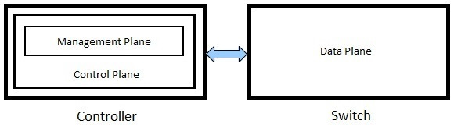

Slide 9
Three planes:
Data, Control, and Management.
The data plane consists of all the messages that are generated by the users.
To transport these messages control messages(control plane) are used.
To keep track of traffic statistics and the state of networking equipment we require network management plane.

Slide 10
What more?

Slide 11
SDN Benefits.
Reference model.
Challenges to SDN.
Centralized vs Distributed.
SDN for Cloud Computing.

Slide 12
SDN Concept
In the SDN architecture,
The control and data planes are decoupled,
Network intelligence and state are logically centralized,
and the underlying network infrastructure is abstracted from the applications.
A network administrator can shape traffic from a centralized control console without having to touch individual switches.

Slide 13
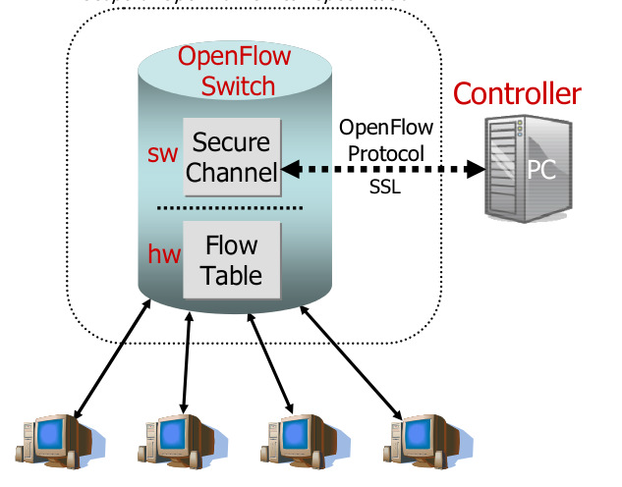
The OpenFlow Project (2008)
First step of achieving SDN’s main concepts (separation of control and programmable networks) in packet switched networks.
The OpenFlow architecture consists of :
A Flow Table in each switch.
A Secure Channel that connects
the switch to the controller.
The OpenFlow Protocol.

Slide 14
SDN Benefits
Enhancing Configuration :
Unification of the control plane over all kinds of network devices, renders it possible to configure network devices from a single point, automatically via software controlling.
Improving Performance :
Centralized control with a global network view and cross-layer communication helps in performance optimization.
Encouraging Innovation :
SDN encourages innovation by providing a programmable network platform to implement, experiment, and deploy new ideas, new applications conveniently and flexibly.

Slide 15
SDN Reference Model
Three layers :
Infrastructure layer.
Control layer.
Application layer.
The infrastructure layer consists of switching devices in the data plane which,
collects network status, storing them temporally in local devices and sending them to controllers.
processes packets based on rules provided by a controller.

Slide 16
The control layer,
specifies functions for controllers to access functions provided by switching devices.
provides service access points in various forms, for example, an Application Programming Interface (API).
The application layer contains SDN applications designed to fulfill user requirements.
Through the programmable platform provided by the control layer, SDN applications are able to access and control switching devices at the infrastructure layer.

Slide 17
Infrastructure Layer
Switching Devices :
have data plane and control plane.
responsible for gathering and reporting network status as well as processing packets based on imposed forwarding rules.
Transmission Media :
Wireless Radio – Software Defined Radio (SDR) permits control of wireless transmission strategy via software.
Optical Fibers – Reconfigurability and single unified control plane over packet and optical networks.

Slide 18
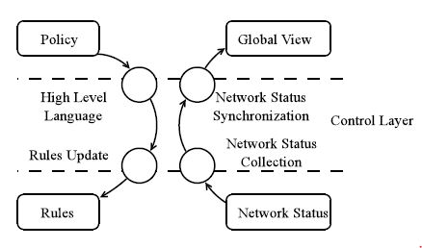
Control Layer
Controller Design :
Network status and updates packet forwarding rules to switching devices through south-bound interface.
Receiving policies described in high level languages and providing a synchronized global view through north-bound interface.

Slide 19
Policy and Rule Validation :
Validation of rules between multiple controllers and application.
Checking of rules on any changes.
Control Layer Performance :
Constrained by the scalability of centralized controllers.
Bandwidth consumption and latency of frequent communication while rule updation and network status collection.

Slide 20
Application Layer
Adaptive Routing :
feeding applications with timely global network status information.
permitting applications to adaptively control a network.
Load Balancing : increase throughput, reduce response time, and avoid overloading of network.
Cross-Layer Design : enhance integration of entities at different layers in a layered architecture.

Slide 21
Boundless Roaming :
common unified control plane.
boundless mobility with seamless wireless connection handover.
connections may be handed over from one base station to another.
Network Maintenance :
central control of an SDN implementation can directly resolve network failures with shorter routing convergence time.
Network Security :
SDN allows analysis of traffic patterns.
Traffic of interest can be explicitly directed to Intrusion Prevention Systems (IPSs).
Install packet forwarding rules to block the attack traffic.

Slide 22
Network Virtualization :
Allow multiple heterogeneous network architectures to cohabit on a shared infrastructure.
FlowVisor is located between guest controllers and switching devices acting as a transparent proxy to filter control messages such that a guest controller can only see and manipulate its own virtual network.

Slide 23
Challenges to SDN
PERFORMANCE VS. FLEXIBILITY
Performance → processing speed of the network node considering both throughput and latency.
Flexibility → capability to change and/or accept a new set of instructions in order to alter functional behavior.
Use of general-purpose processors, provides high flexibility. High-level programming languages enable the highest design abstraction and development of packet processing functions.
Limitation is its performance and power dissipation.
So, hybrid approach will be needed.

Slide 24
SCALABILITY
Latency introduced by exchanging network information between multiple nodes and a single controller.
Communication of SDN controllers with other controllers using the east and westbound APIs.
Size and operation of the controller back-end database.
A specific solution to controller scalability is HyperFlow, that sits on NOX and allows the network operators to have as many controllers as required. All the controllers share the same consistent network-wide view.

Slide 25
SECURITY
authentication and authorization mechanisms, in a multi-tenant setting, that would allow protection of resources of multiple organizations accessing the network.
The controllers are a particularly attractive target for attack, open to unauthorized access and exploitation.
INTEROPERABILITY
Coexistence of SDN and the legacy equipment.
Appropriate protocol that both introduces the requirements for SDN communication interfaces and provides backward compatibility with existing IP routing and multiprotocol label switching (MPLS) control plane technologies.

Slide 26
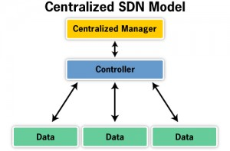
Centralized vs. Distributed SDN
In the centralized model, a centralized manager with a single controller talks to distributed data planes.
The route and data flow definitions are all done within that centralized manager.
Issues with scaling.

Slide 27
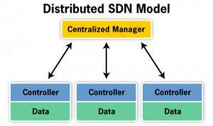
In the distributed model, a centralized manager talks to combined distributed controller and data planes.
It looks as if controlling the system as a whole, even though it is really individually managing each node in the distributed network.
Easy to scale.

Slide 28
SDN for Cloud Computing
In a software defined network, administrator can change any network switch's rules when necessary - prioritizing, de-prioritizing or even blocking specific types of packets with a very granular level of control.
Helpful in a cloud computing multi-tenant architecture because it allows the administrator to manage traffic loads in a flexible and more efficient manner.
Essentially, this allows the administrator to use less expensive, commodity switches and have more control over network traffic flow than ever before.

Slide 29
Poor network conditions such as congestion or connection faults can be remediated.
To enable cloud computing, you have to be able to dynamically provision the network, a task at which SDN is eminently suitable.
There are routing and switching tables that must be updated, and firewall rules that must be put into place.
Application services - load balancing, acceleration and optimization, and application security.
All needs to be abstracted and managed programmatically.

Slide 30
OpenStack?
Cloud management platform.
Enables a software-defined environment.
i.e. through programmatic interfaces the ability to automate and orchestrate the provisioning and management of data center resources.
pulls together the various data center components - from storage to compute, from application services to network services - and provides the means to manage them all holistically via software.
SDN is well-suited to enabling the programmatic provisioning and management necessary to implement a cloud computing environment.

Slide 31
THANK YOU !!!

